Slide 1
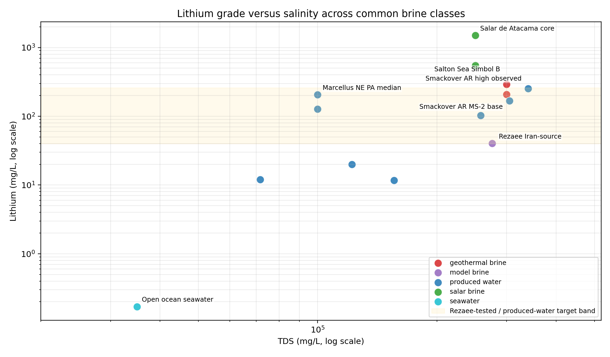
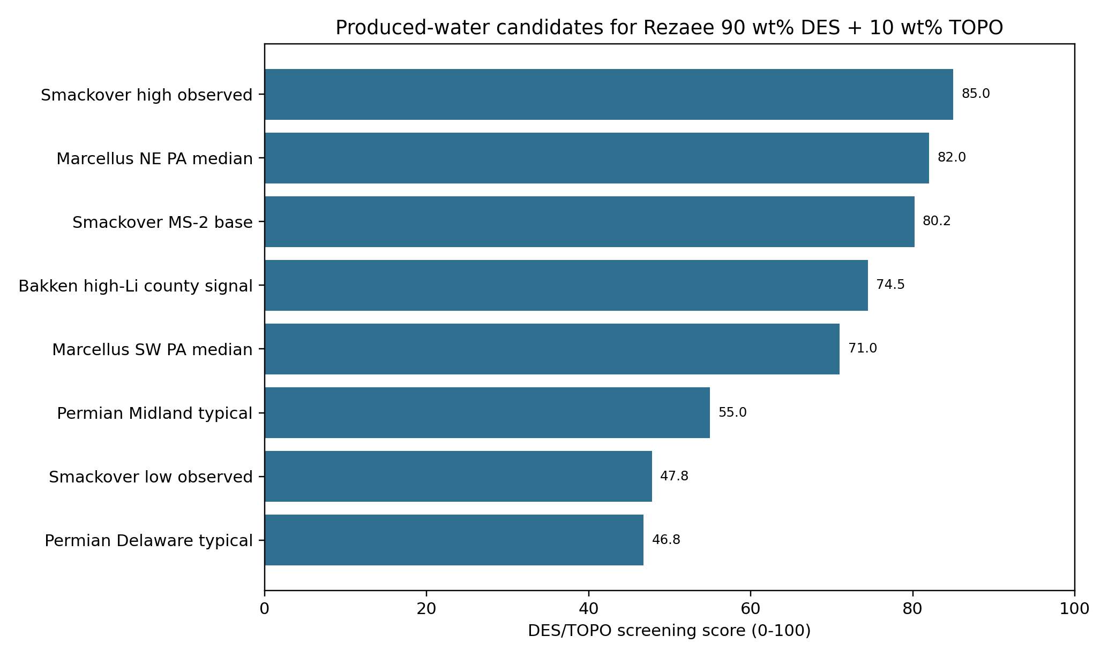
Produced-Water Lithium Extraction
Rezaee DES/TOPO Li/Na bridge for PrOMMiS and IDAES integration
LI FEED
NA FEED
NOMINAL LI EXTRACTION
168 mg/L
64,100 mg/L
50.66%

Slide 2
1. Case Basis
A Smackover produced-water problem becomes tractable only after divalent pretreatment defines a clean Li/Na extraction feed.
BRINE BASIS
LI
NA
TDS
Smackover
168 mg/L
64,100 mg/L
305,000 mg/L

Slide 3
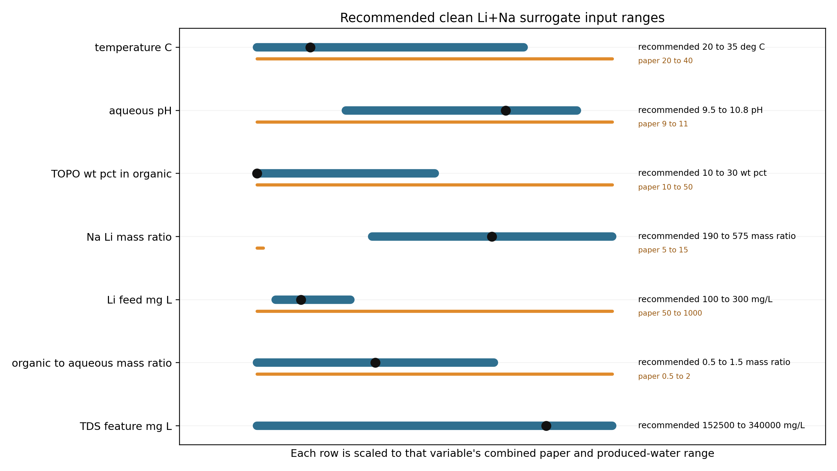
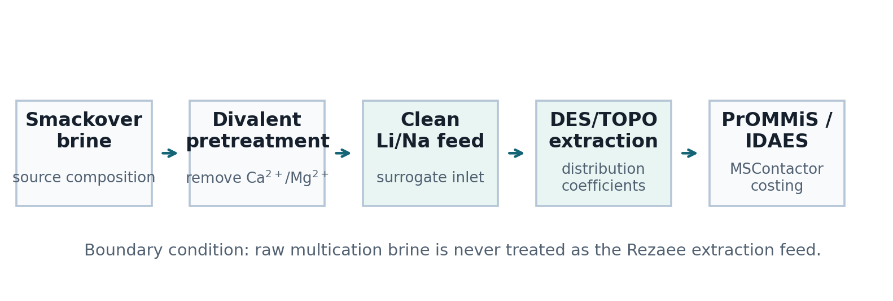
Smackover Feed And Pretreatment Boundary
The case basis is source-backed; the extraction chemistry is literature-backed.
ENGINEERING READOUT
01
The solvent model sees a clean Li/Na stream, not raw multication produced water.
02
Ca/Mg/Sr/Ba are upstream pretreatment species and remain outside the active extraction model.
03
TDS remains a severity variable for process screening and uncertainty sweeps.

Slide 4
2. Thermodynamic Bridge
Rezaee DES/TOPO is used as a traceable Li/Na distribution bridge, not as an unsupported fixed recovery factor.
SOLVENT
BRIDGE
ROWS
FLAG
DES + TOPO
log-D
523
Na/Li extrapolation

Slide 5
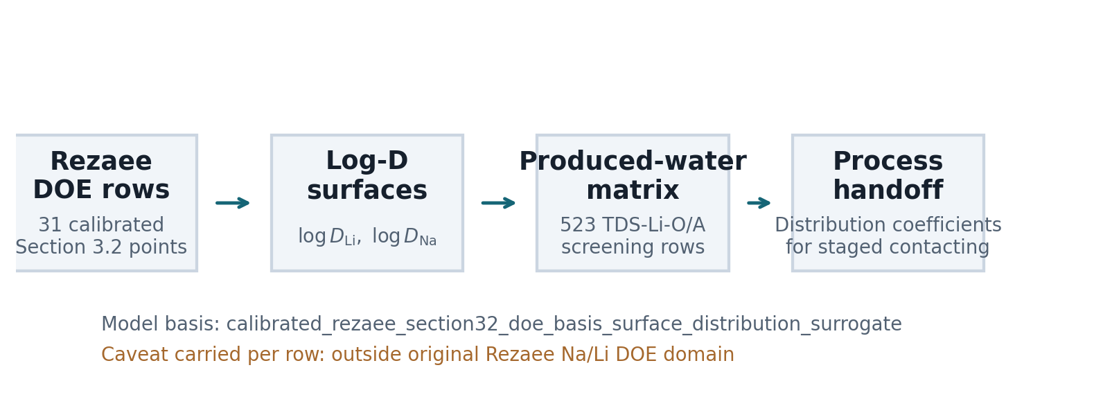
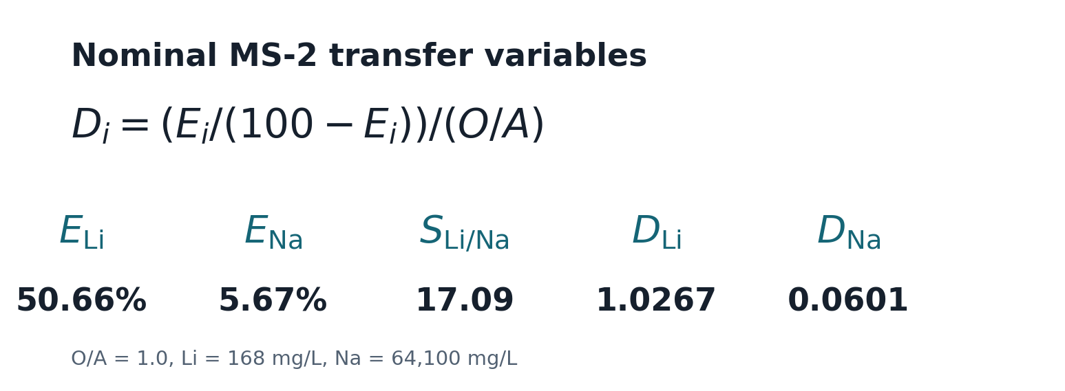
Rezaee DES/TOPO Surrogate Construction
The active model is a distribution-coefficient surrogate tied to literature extraction evidence.
ENGINEERING READOUT
01
Convert Rezaee extraction responses into distribution coefficients using the organic-to-aqueous basis.
02
Fit calibrated log-distribution response surfaces for Li and Na transfer.
03
Carry model-basis and validity flags into every PrOMMiS/IDAES handoff row.

Slide 6
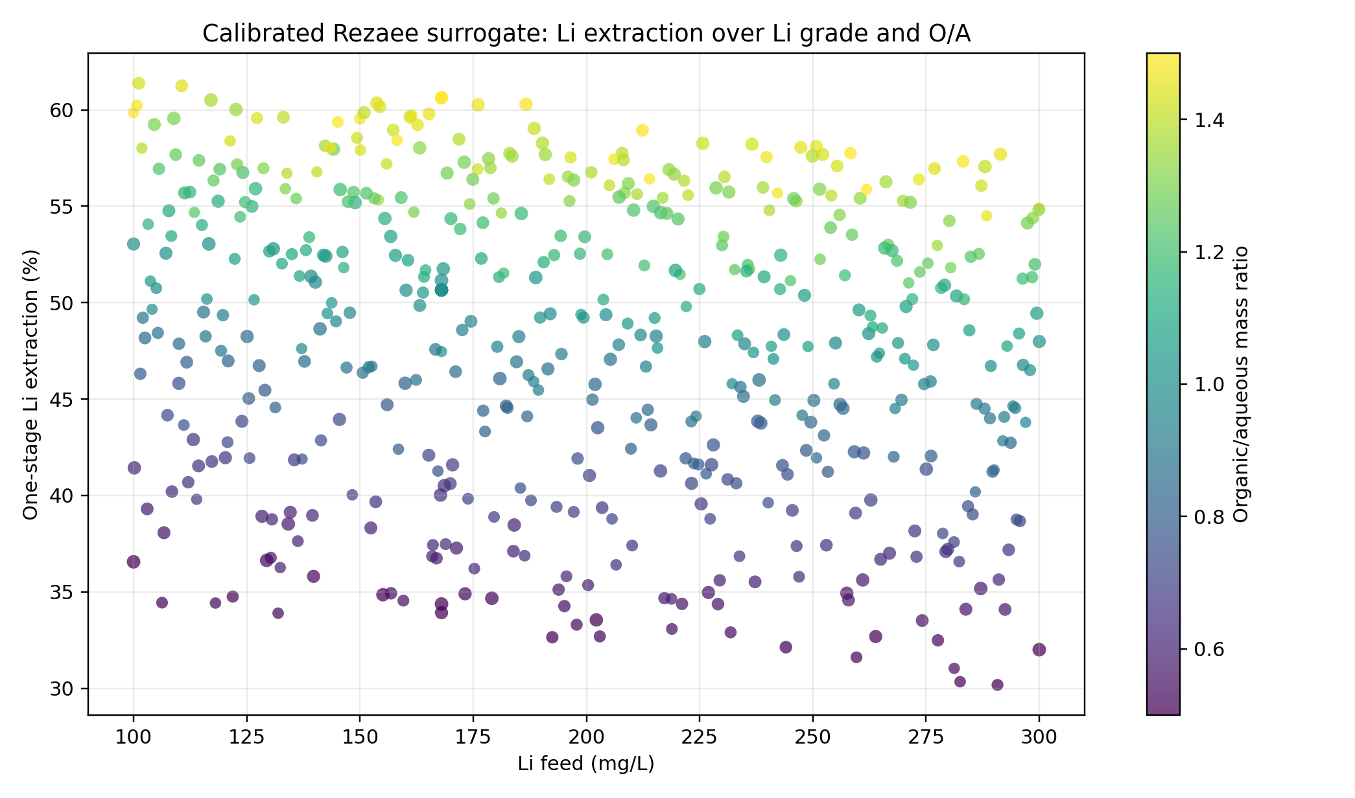
Lithium Extraction Surface
The surrogate returns finite process responses across the produced-water screening matrix.
ENGINEERING READOUT
01
Lithium extraction spans 30.2-61.4% across the current screening matrix.
02
Nominal MS-2 one-stage lithium extraction is 50.66%.
03
The organic/aqueous ratio is the dominant operating lever in the three-variable sweep.

Slide 7
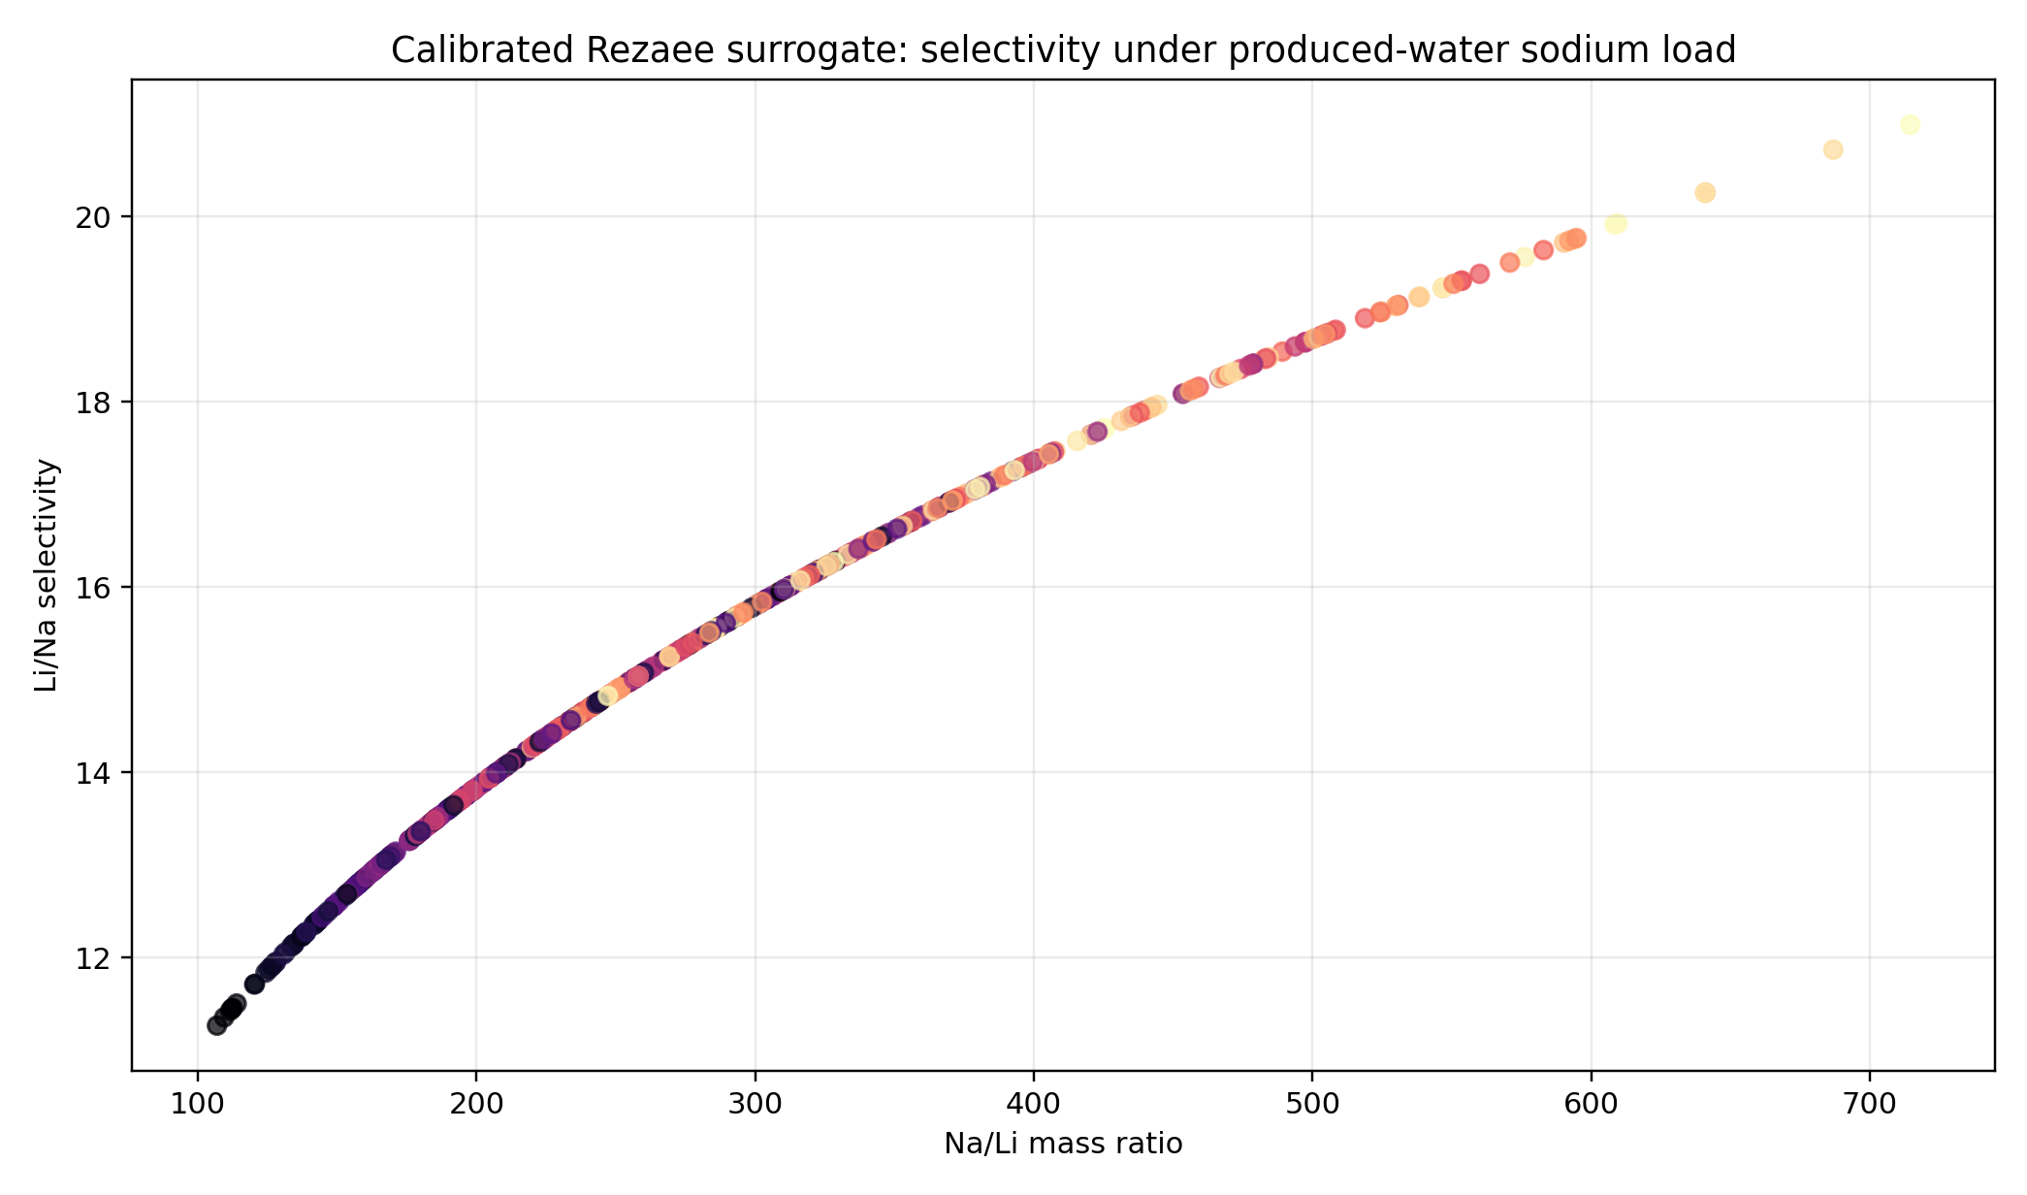
Selectivity Under Produced-Water Sodium Load
The result is a staged-contacting contract, not only a recovery percentage.
ENGINEERING READOUT
01
Nominal Li/Na selectivity is 17.09 at the clean MS-2 point.
02
Corrected distribution coefficients are the primary variables for MSContactor handoff.
03
The high Na/Li point is extrapolated beyond the original Rezaee DOE range and must stay flagged.

Slide 8
3. Process Integration
The value of the thermodynamic bridge is that it produces process-model inputs with traceable validity flags.
OUTPUT
UNIT
SYSTEM
COSTING
D_i
MSContactor
PrOMMiS
IDAES

Slide 9
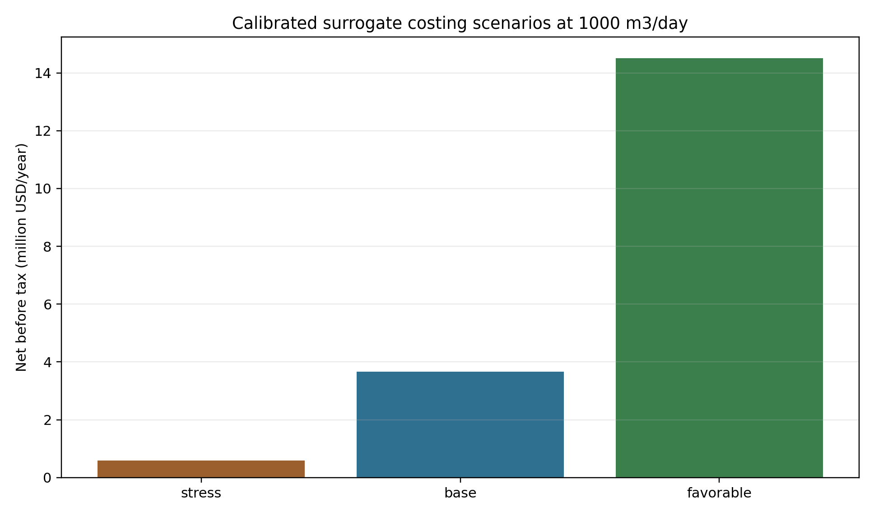
PrOMMiS/IDAES Handoff
Transfer variables are connected to staged recovery and screening economics.
ENGINEERING READOUT
01
The handoff table carries extraction, selectivity, distribution coefficients, raffinate, and extract loading.
02
Costing scenarios use calibrated surrogate recovery values at the same feed-flow basis.
03
Economics remain screening-level until residence time, solvent loss, reagent demand, and product pricing are specified.

Slide 10
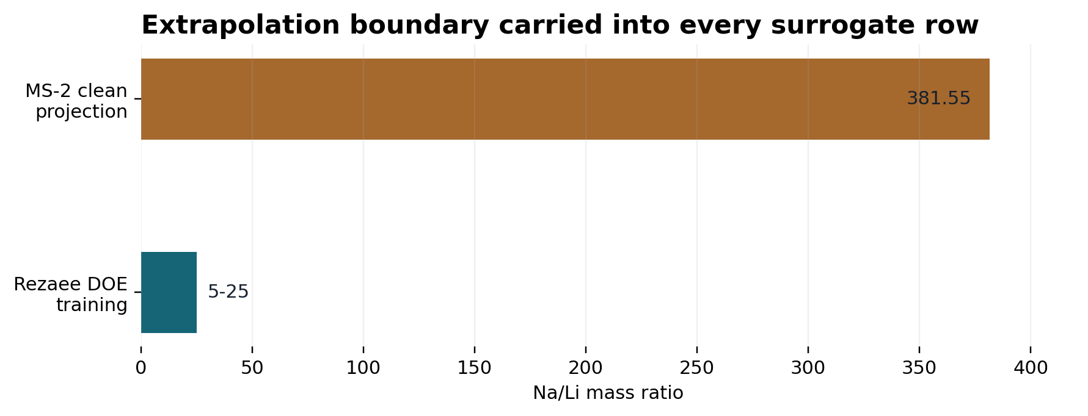
Validation Boundary
The key caveat is sodium-load extrapolation from Rezaee DOE space to Smackover water.
ENGINEERING READOUT
01
Every produced-water row is flagged as outside the Rezaee DOE Na/Li training domain.
02
Process screening is appropriate; high-Na/Li validation remains future work.
03
Direct reactive-LLE closure is not claimed; the calibrated distribution surrogate is the presentation basis.

Slide 11
Presentation-Ready Chain
The story now runs from feed definition through process-screening economics.
ENGINEERING READOUT
01
Use the calibrated Rezaee surrogate matrix as the active data product for the case-study deck.
02
Keep archived solvent-selection material outside the current Rezaee-calibrated presentation chain.
03
Next step: replace the algebraic process handoff with a full PrOMMiS MSContactor solve and IDAES costing block.

